Slide 1
The Signal Saviors - Traffic Sign Recognition System
The Signal Saviors Danielle S. Raynor, Kevin Allen, Adnan Hasan, Sahad Rafiuzzaman, Noah Roberson

Slide 2
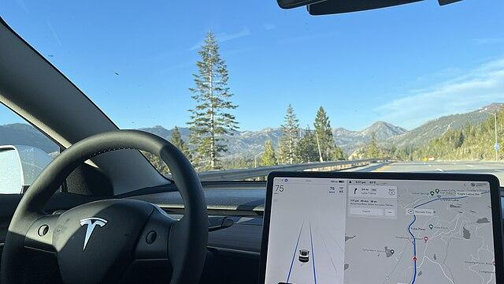
Domain & Motivation
Domain:
The main domain that would use traffic sign recognition would be autonomous vehicles to ensure safety.
Motivation:
The motivation behind this AI model was to help autonomous vehicles adhere to traffic regulations and mitigate cyber attacks that confuse the vehicles

Slide 3
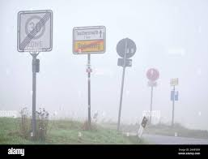
Problem Statement
Challenge
With rapid expansion in road networks and varying road signs poses a challenge for consistent detection, especially in autonomous and driver-assistance systems.
Key Issues
Recognition Difficulties: Varying lighting, weather conditions, and partial occlusions impact sign visibility.
Safety Risk: Misinterpretations of road signs can lead to potential traffic violations and accidents.

Slide 4
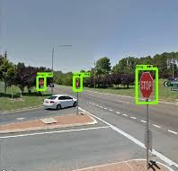
Problem Solutions
Objective
Develop an AI-based solution that accurately detects and interprets road signs in real-time.
Approach
Use CNNs for fast, efficient feature extraction and classification.
Real-Time: Optimized for instant decision-making.
Model
CNN Architecture: Designed for reliable road sign detection.
Data
Diverse Datasets: Training across varied conditions (lighting, weather, occlusion) for improved accuracy.

Slide 5
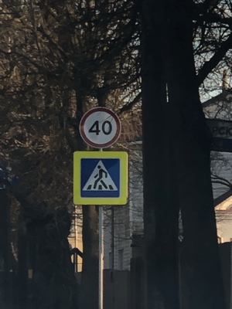
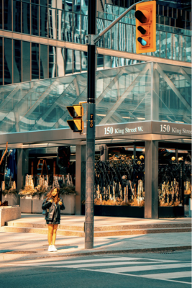
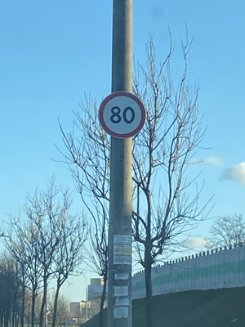

Dataset Description
Dataset Overview:
Images of various road signs, categorized into classes like traffic lights, stop signs, yield signs, and speed limit signs.
Each image is paired with a label identifying the type of road sign.
Data Structure:
Primarily unstructured with images in different resolutions and formats.
Project Relevance:
Investigate the impact of data poisoning by generating and adding altered images designed to mislead the model.
Dataset Source:
https://www.kaggle.com/datasets/andrewmvd/road-sign-detection
877 images and 4 different classes.

Slide 6






Tools & Technologies
Development Tools
Python: Core programming language for AI model creation and development.
Libraries
TensorFlow & Keras: Model building and training for robust neural networks.
OpenCV: Handles image processing task for sign detection.
Scikit-learn: Evaluates model performance and calculate metrics.
Platform
Google Colab: Provides an interactive, cloud-based development environment for efficient coding, data analysis, and documentation.

Slide 7

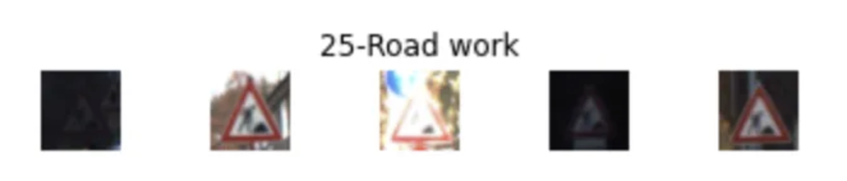
Expected Output
Goal Develop a trained AI model capable of accurately classifying road signs under standard conditions.
Performance Metrics
Accuracy: Overall correctness of classifications.
Precision: Correctly identified road signs out of all positive predictions.
Recall: Correctly identified road signs out of all actual positives.

Slide 8
System Architecture
Data Preparation:
Datasets and Preprocessing
Model Building:
Convolutional neural network
Model Training:
Separating Signs into classes and compiles metrics
Visualization:
Selecting Random Images to Identify
Model Evaluation:
Accuracy and Loss

Slide 9
Codebase Description: Data Capture and Preprocessing
This involves the import of the necessary libraries such as: cv2, PIL, and tensorflow
The download of the datasets through the Kaggle API
Verifying the file integrity and types
Preprocessing the images resizing, converting to NumPy arrays, and one-hot encoding labels
Lastly, it splits the datasets into training and testing sets

Slide 10
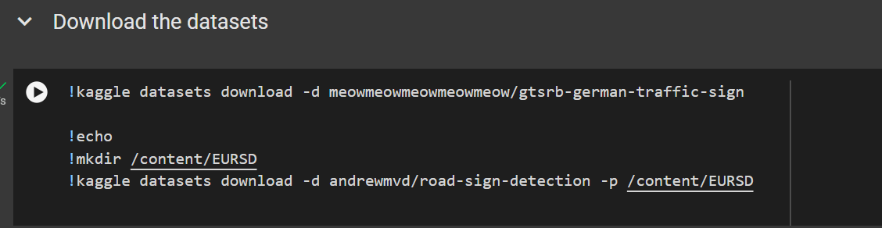
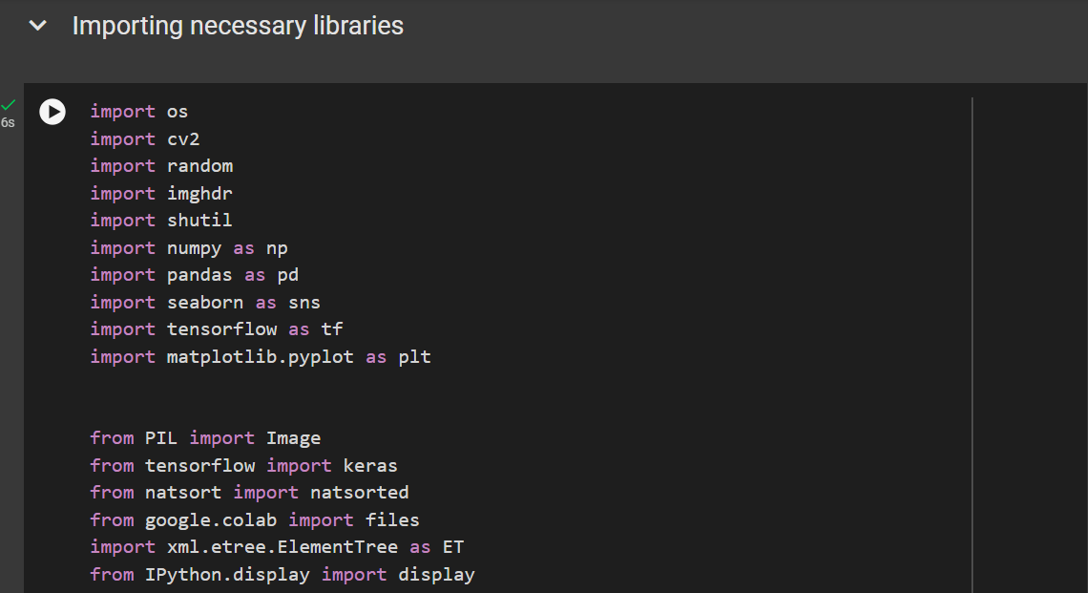
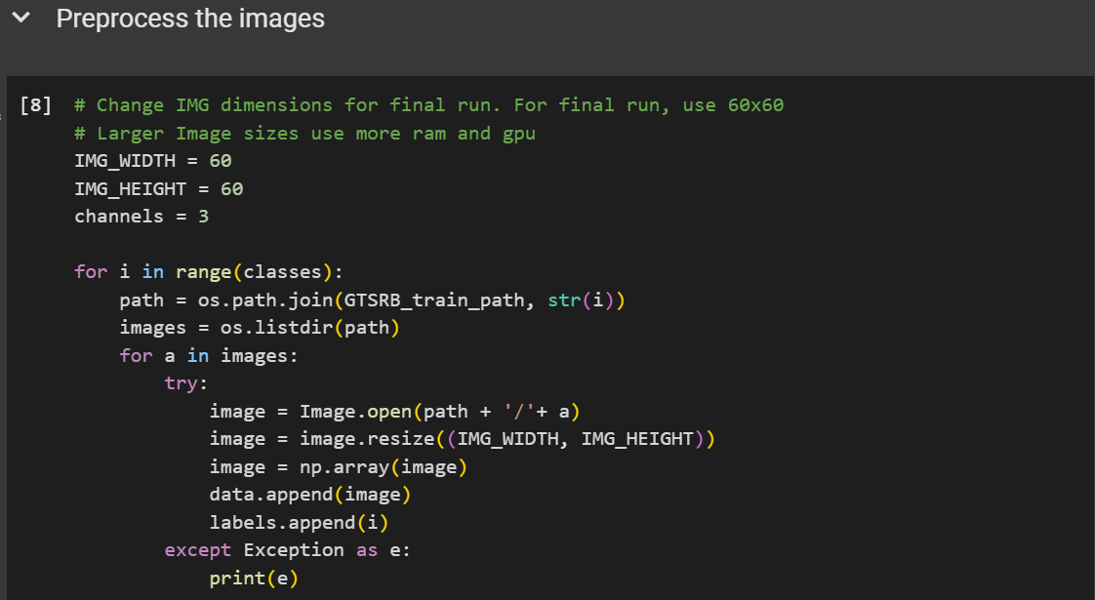
Data Capture and Preprocessing Code Snippets

Slide 11
Codebase Description: Model Building and Training
Defines a Convolutional Neural Network (CNN) using Keras Sequential API
The model consists of convolutional layers, max pooling layers, dropout layers, a flatten layer, and dense layers for classification
Compiles the model with categorical_crossentropy loss, adam optimizer, and accuracy metric
Trains the model on the training data for a specified number of epochs and batch size

Slide 12
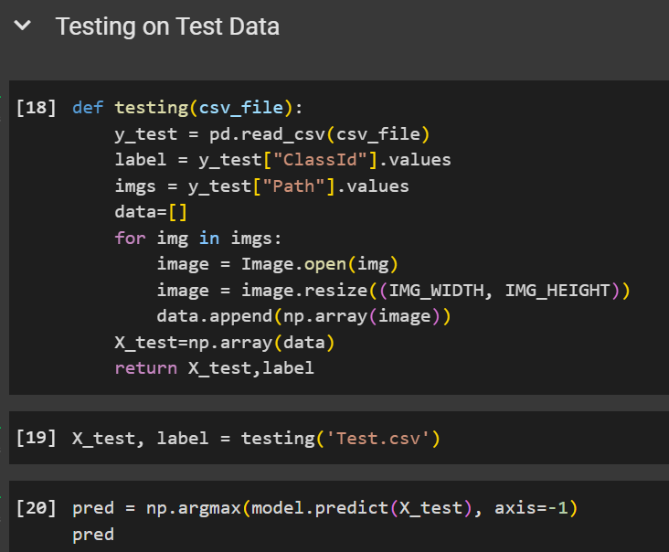
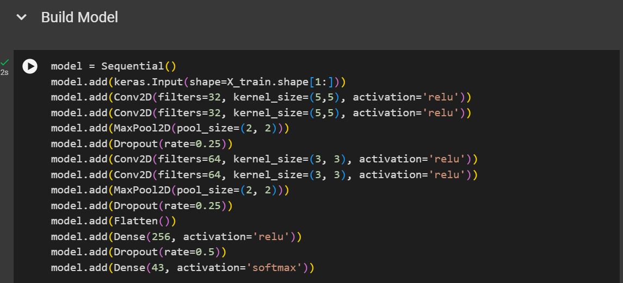
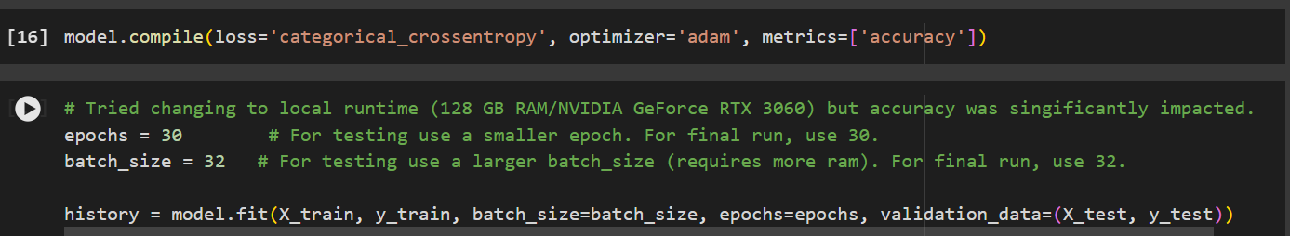
Model Building and Training Code Snippets

Slide 13
Codebase Description: Testing and Evaluation
Defines a function testing to load and preprocess test data from a CSV file
Loads the data sets test data and predicts the labels using the trained model
Defines a dictionary classes mapping class indices to traffic sign names
Provides a function test_on_img_colab for running predictions on user-uploaded images
Evaluates the model using accuracy, loss plots, confusion matrix, and classification report

Slide 14
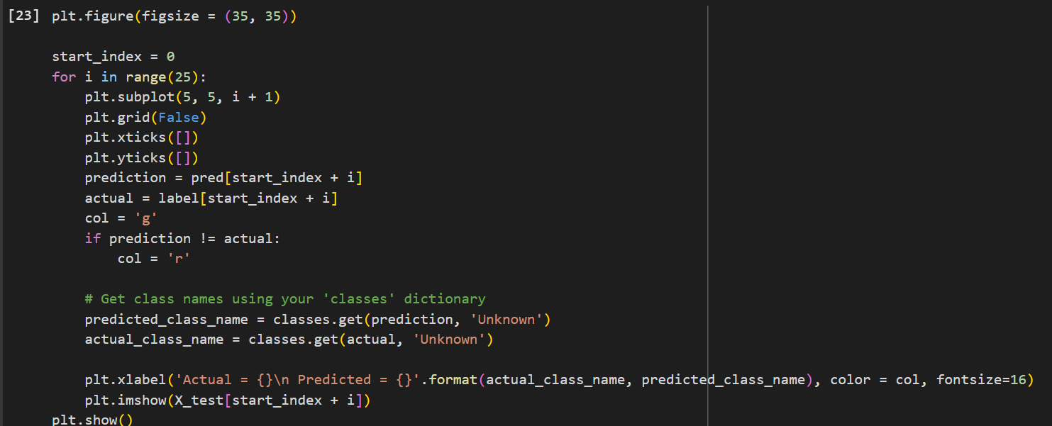
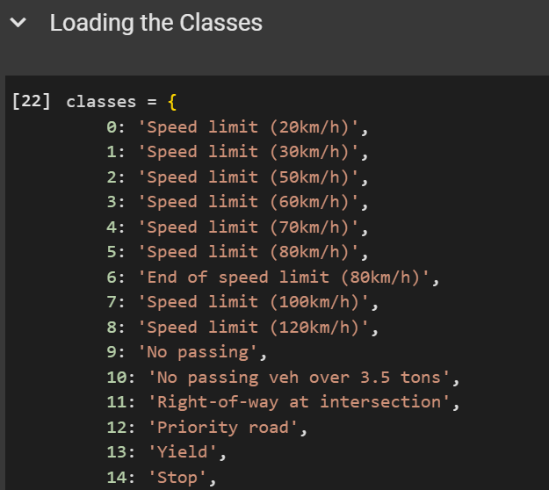
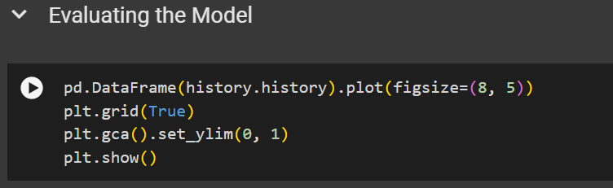
Testing and Evaluation Code Snippets

Slide 15
Codebase Description: Data Exploration and Visualization
Analyzes the training dataset by counting images per class and visualizing the distribution
Visualizes random images from the training, testing, and EURSD datasets
Extracts and visualizes data for specific sign categories from the dataset
Analyzes model predictions on the dataset for different traffic sign classes

Slide 16
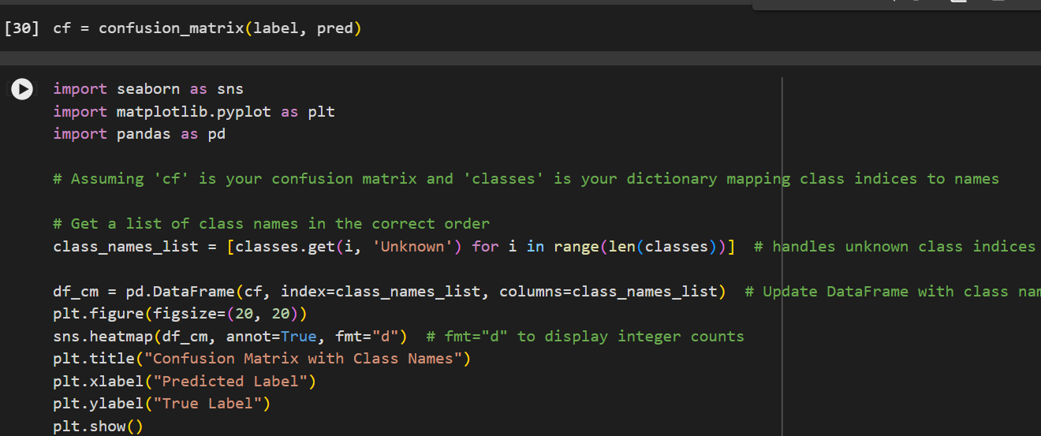
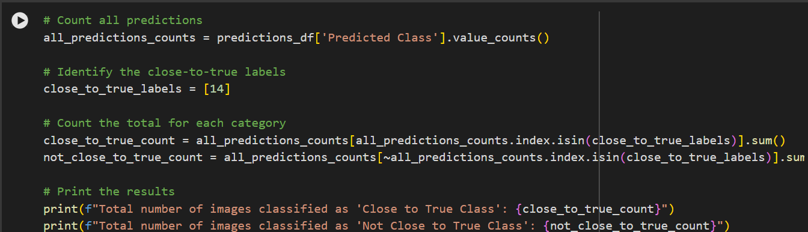
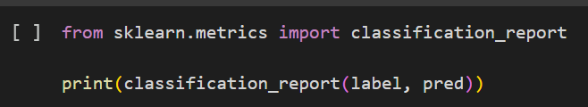
Data Exploration and Visualization Code Snippets

Slide 17
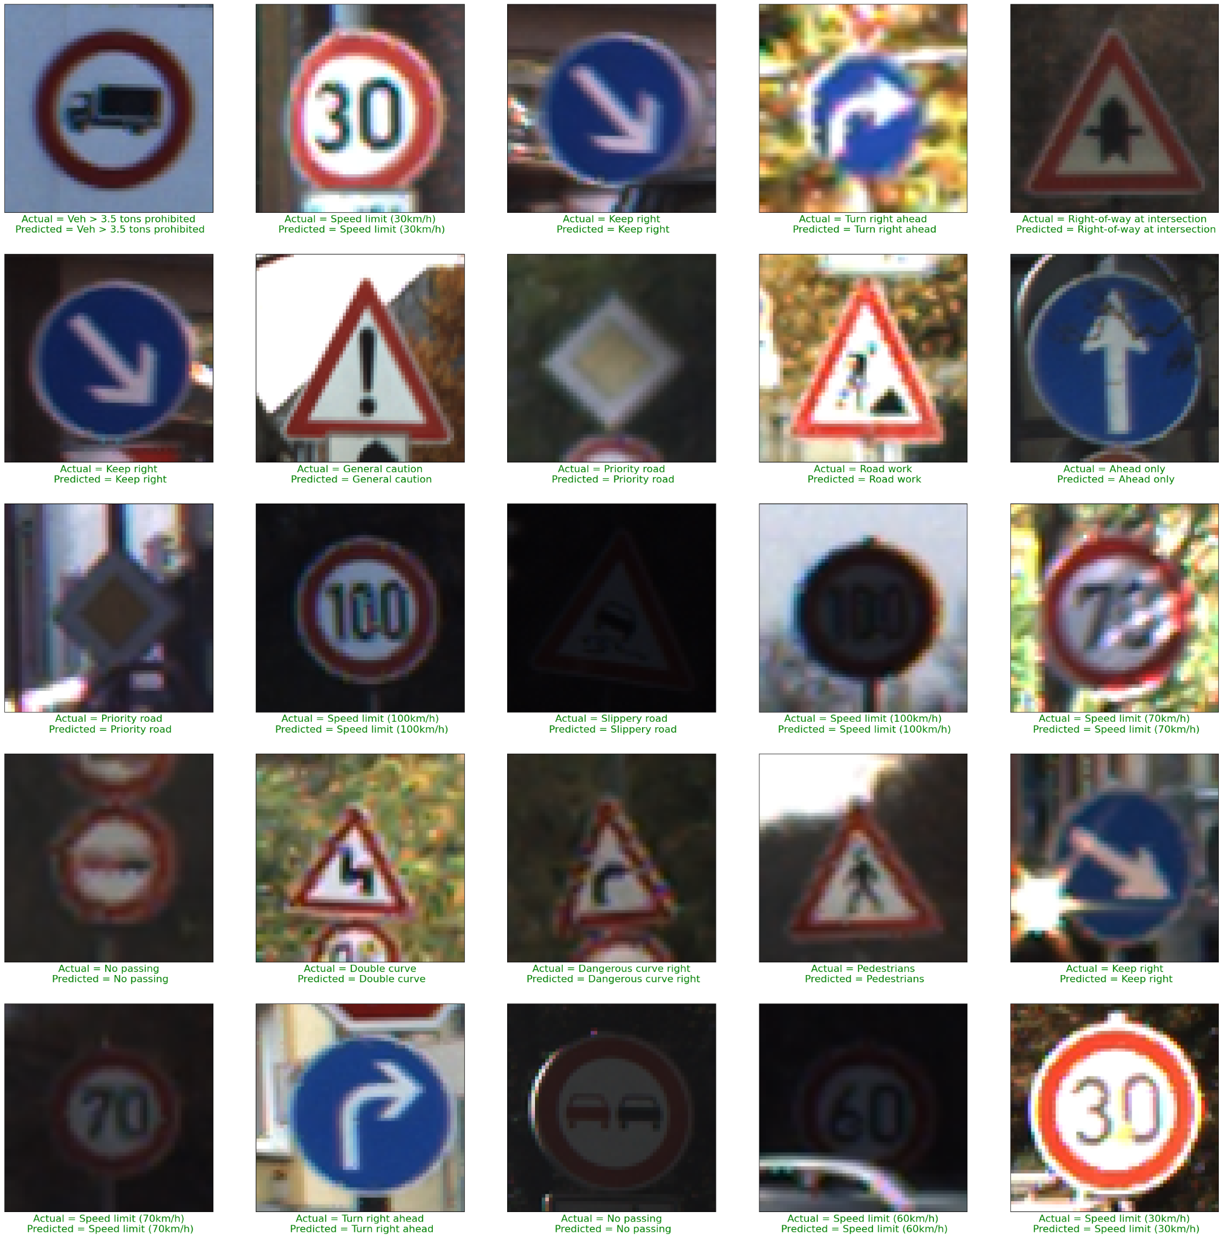
Prediction Set Results
The following image is the results on the prediction set with pictures of traffic signs. Under each traffic sign is what the sign is and what the model predicted.

Slide 18
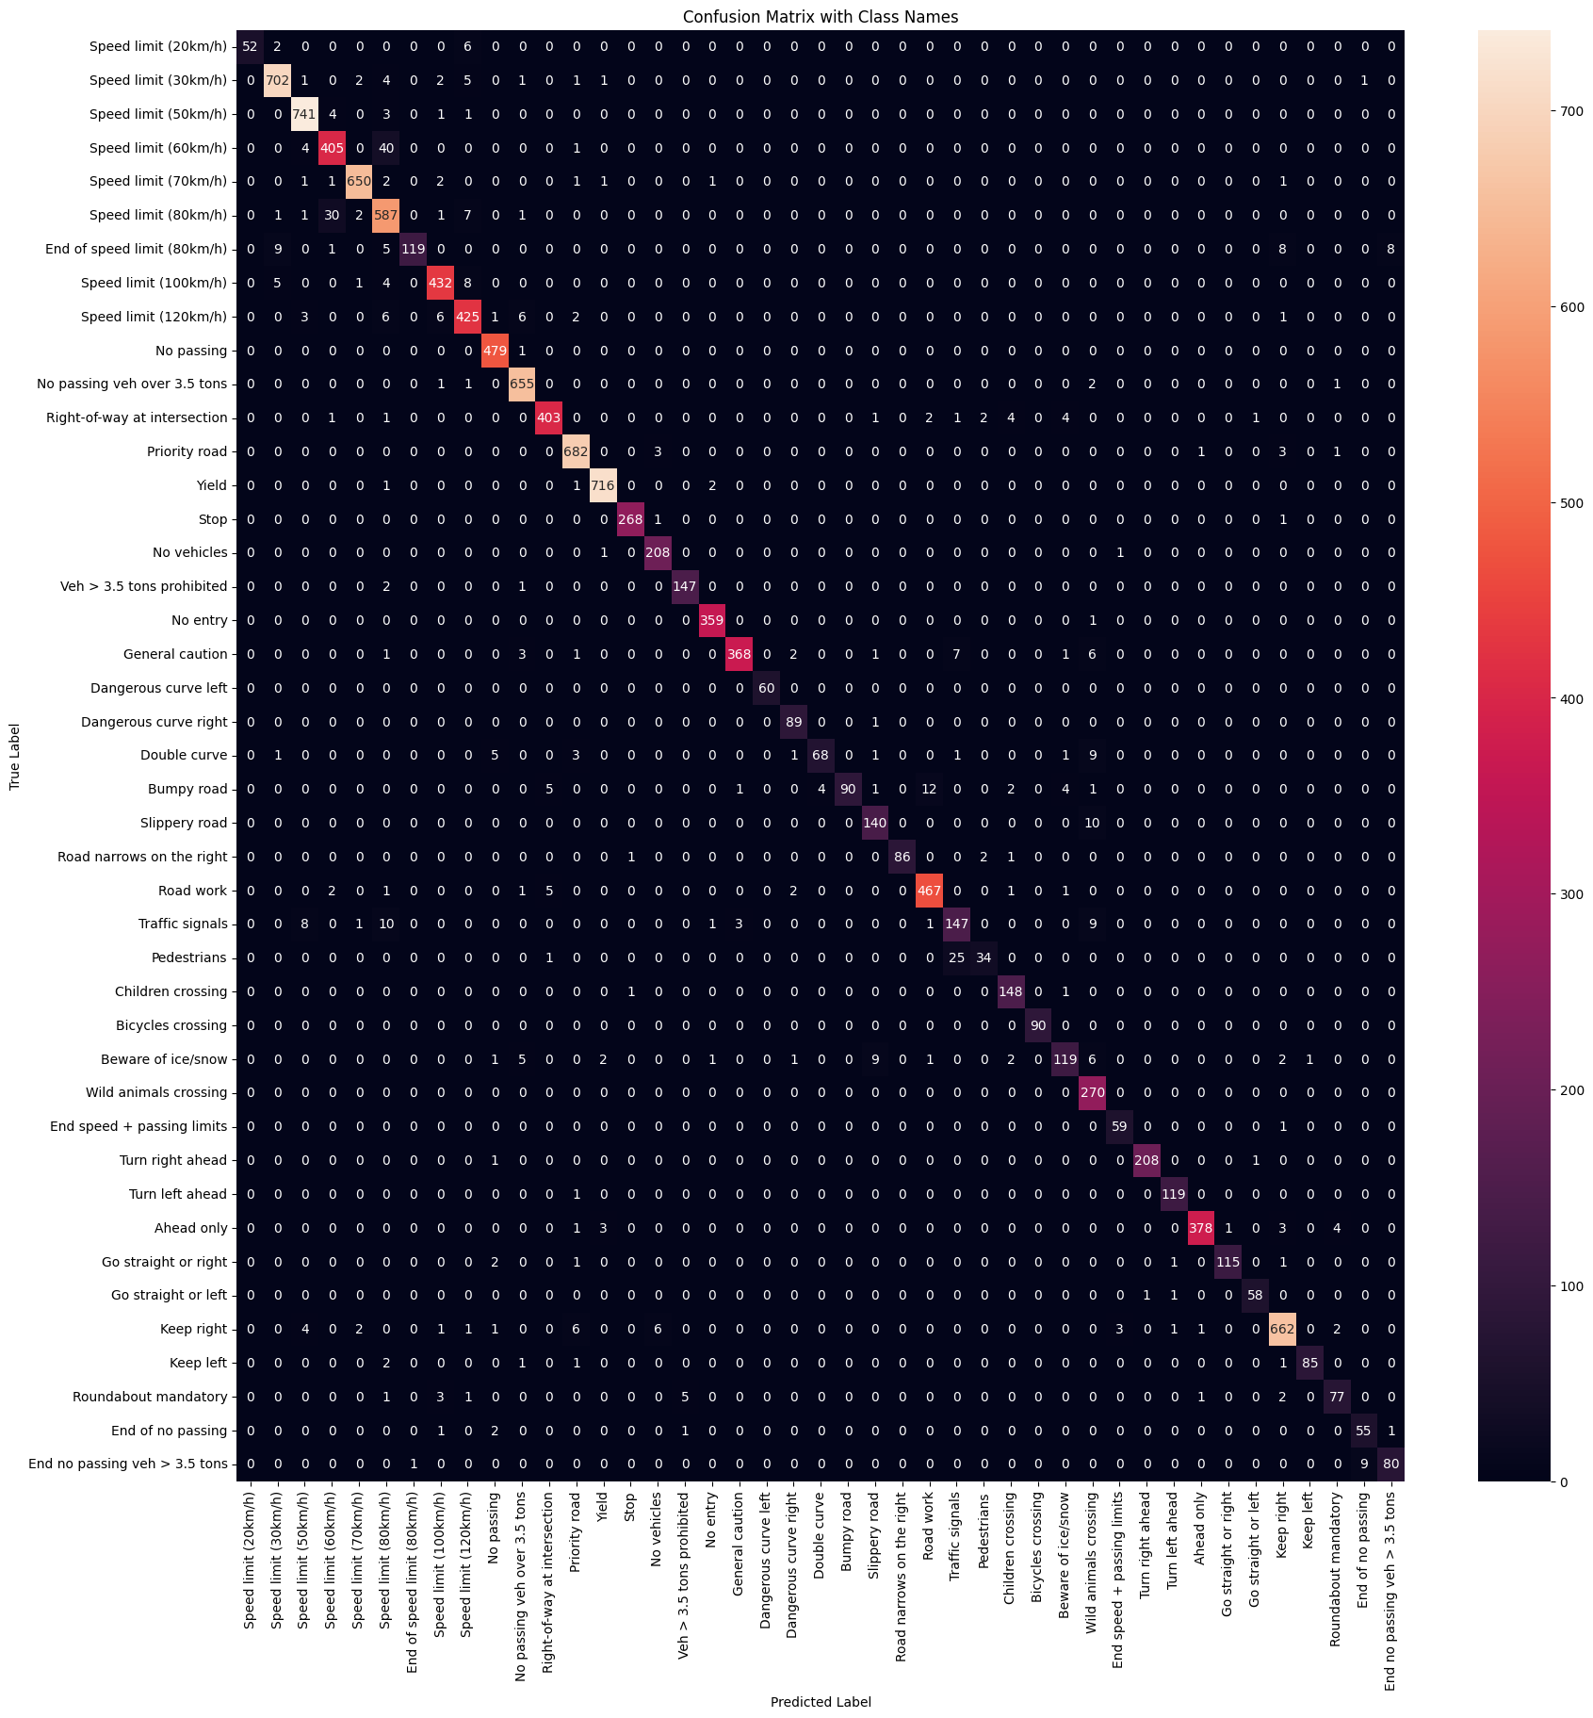
Training Confusion Matrix Results

Slide 19
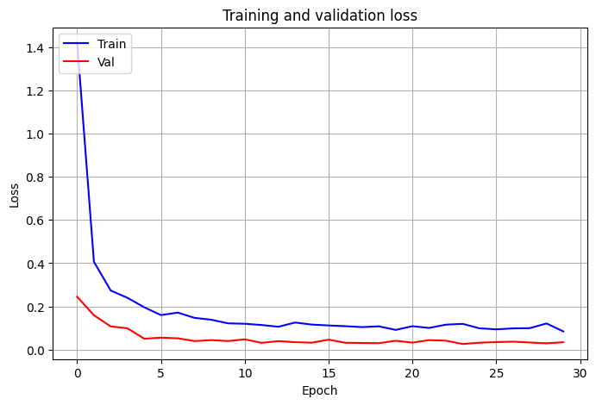
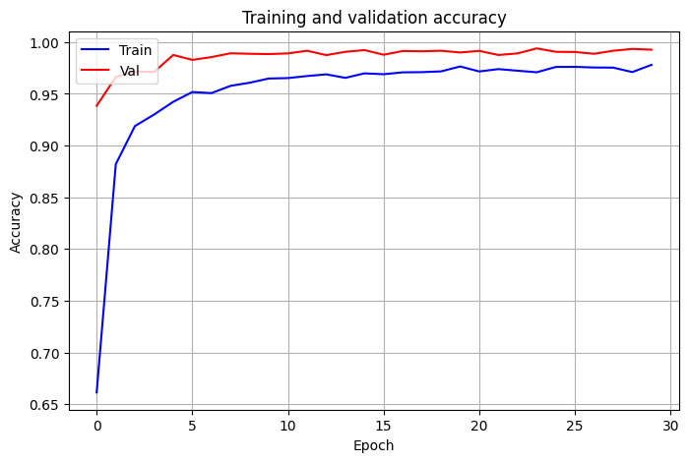
Accuracy & Loss of the Prediction Set Results

Slide 20
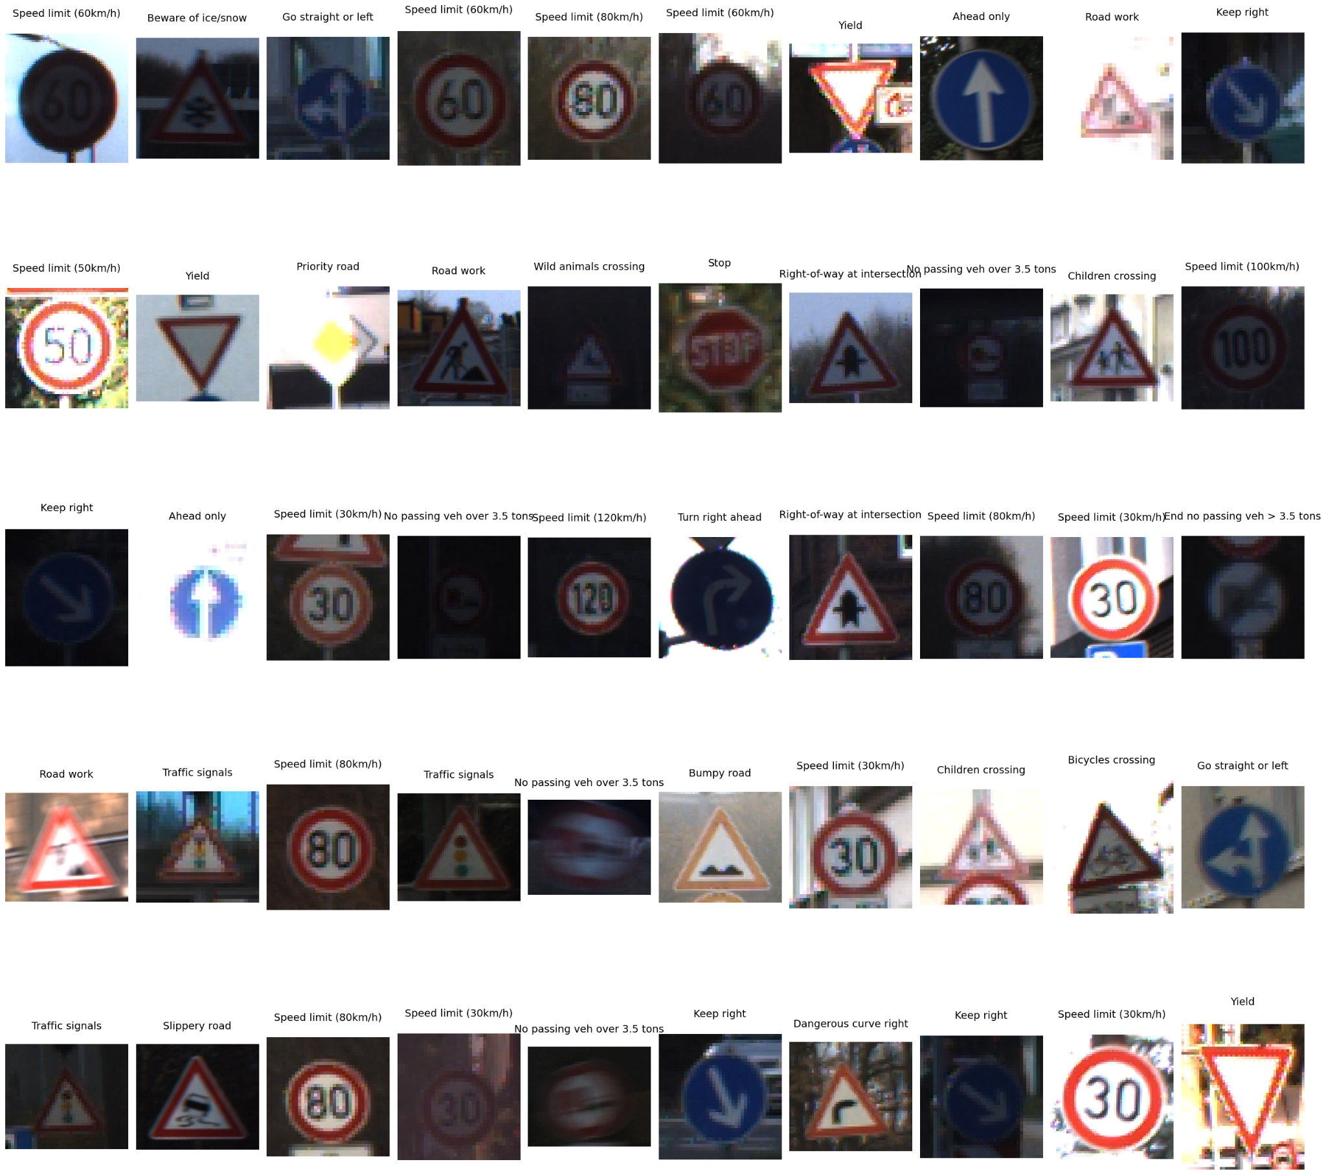
Visualizing 50 Random Images Results
The image shows the results of 50 randomly selected traffic signs and the classification the AI model gave to each sign.

Slide 21
Conclusion
The traffic sign recognition system proposed in this project aimed to create a robust and scalable model that could accurately identify traffic signs from images
We focused on using Python, along with powerful libraries such as TensorFlow, Keras, and OpenCV, to preprocess images, augment data, and build the machine learning model
Using techniques like image augmentation and evaluation metrics such as accuracy, precision, and recall, the system was able to demonstrate promising results

Slide 22
References
Larxel. (2020). Road Sign Detection. Kaggle.com. https://www.kaggle.com/datasets/andrewmvd/road-sign-detection
Mykola. (2018). GTSRB - German Traffic Sign Recognition Benchmark. Kaggle.com. https://www.kaggle.com/datasets/meowmeowmeowmeowmeow/gtsrb-german-traffic-sign

